Slide 1





HOME CREDIT LOAN RISK Group 5
Athulya Anand Shubham Patil Sricharraan Ramaswamy Varsha R
2000923101 2000938033 2000855651 2000751388
athanand@iu.edu shupatil@iu.edu sriramas@iu.edu varavi@iu.edu

Slide 2
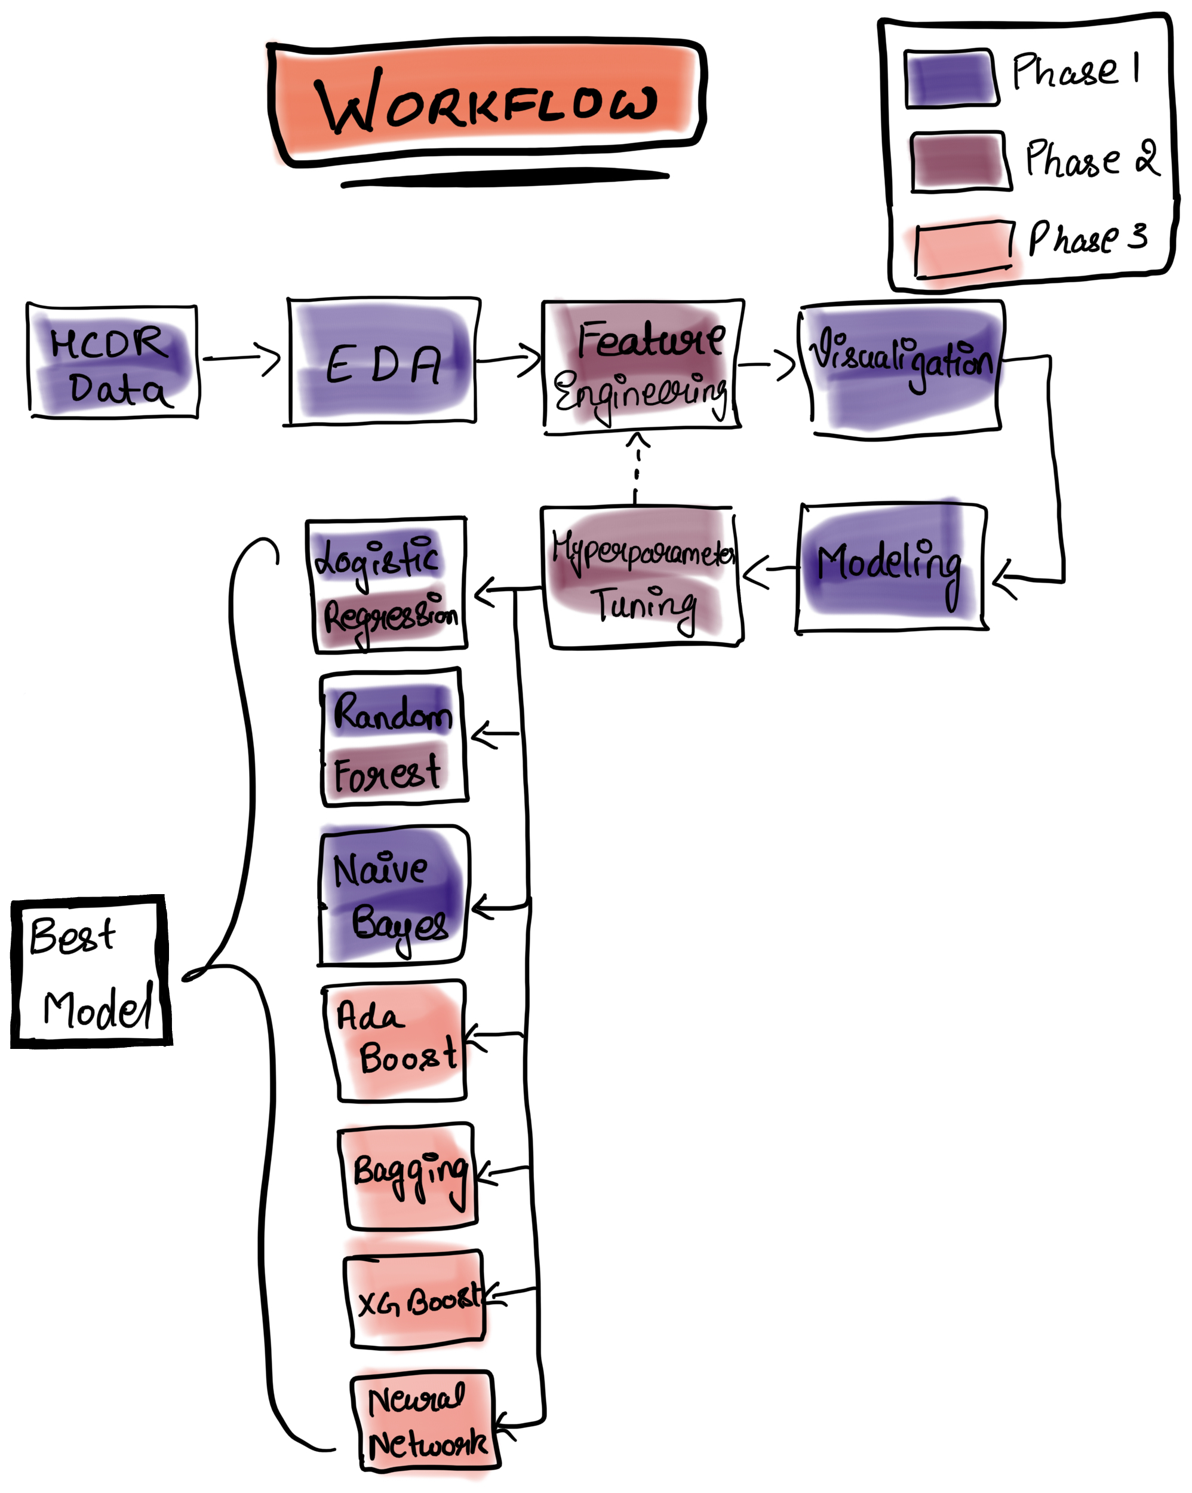
Outlines and Tasks
Project Description
Phase 3 Workflow
Phase 3 Baseline Modeling
Logistic Regression Random Forest Classifier
Metrics
Phase 2:
Hyperparameter Tuning
Summary of Previous Phases
Accuracy Log Loss
F-1 Score Confusion matrix
ROC-AUC
Feature Engineering
Phase 1:
Exploratory Data Analysis and Visualization
Data Cleaning & Processing
Featured the Data using OHE
Created a Baseline Pipeline model for Logistic Regression, Naïve Bayes and Random Forest Classifier.
Naïve Bayes Adaboost
Xgboost Bagging
Phase 3 Main Tasks
Building Multilayer Perceptron model and ANN using Pytorch & Study of Leakage
Tensorboard visualization for the results
Home credit utilizes several alternative data and methods to predict their client’s repayment abilities.

Slide 3
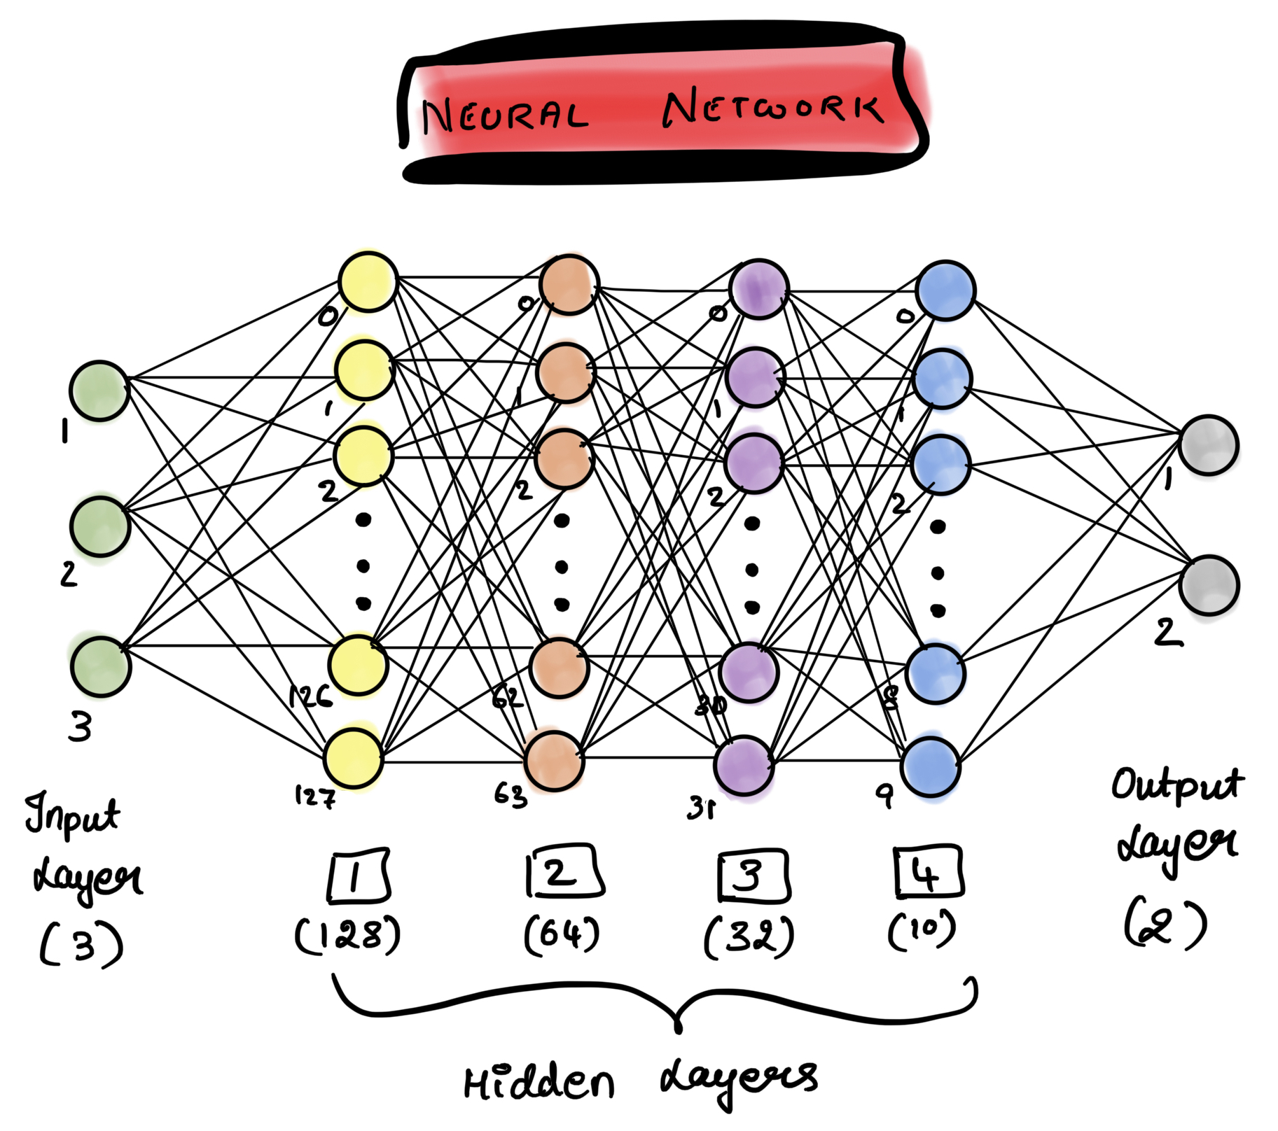
Phase 3 Approach
Use a Multi Layer Perceptron (MLP) Model using Pytorch for loan default classification:
We used Pytorch to create an MLP model and an Artificial Neural Network with four hidden layers, each with 128, 64, 32, and 10 neurons, and an output layer with two neurons.
We used the relu activation function as our activation function.
The cross-entropy loss was utilized as the loss function for this model, and the Adam optimizer was used as the optimizer (after experimenting with several optimizers).
We chose 0.001 as the learning rate for this model after experimenting with other learning rates.
Finally, the neural network model was trained for 500 epochs and the final predictions were subjected to a softmax function to obtain a probabilistic answer.
Study of Leakage
For the pipeline that we have used, we see that there is no data leakage as we have dealt with all NaN values appropriately, and the data type has been set uniform across columns.
We have also ensured that the new features that we have generated during feature engineering have been used appropriately during training and is available at the time of inference.

Slide 4
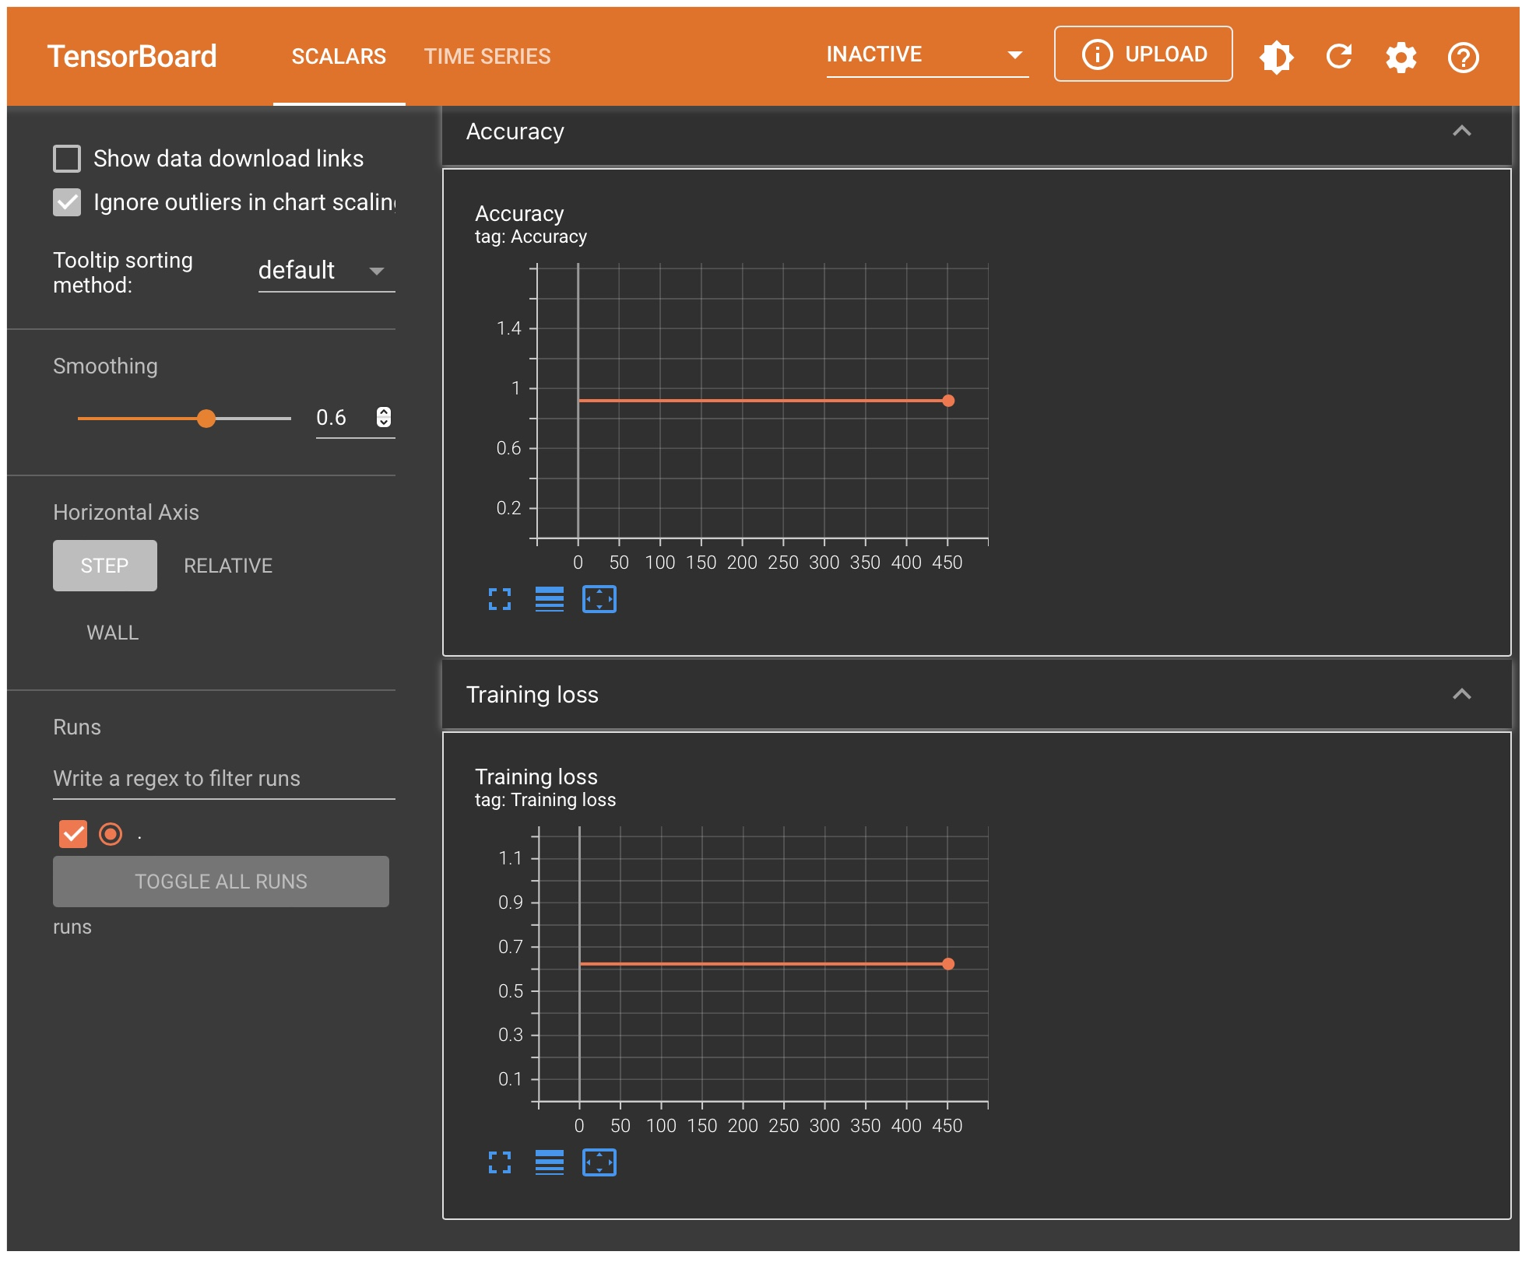
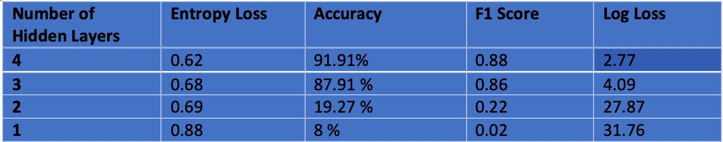
Tensor board to visualize the results of training and modeling

Slide 5
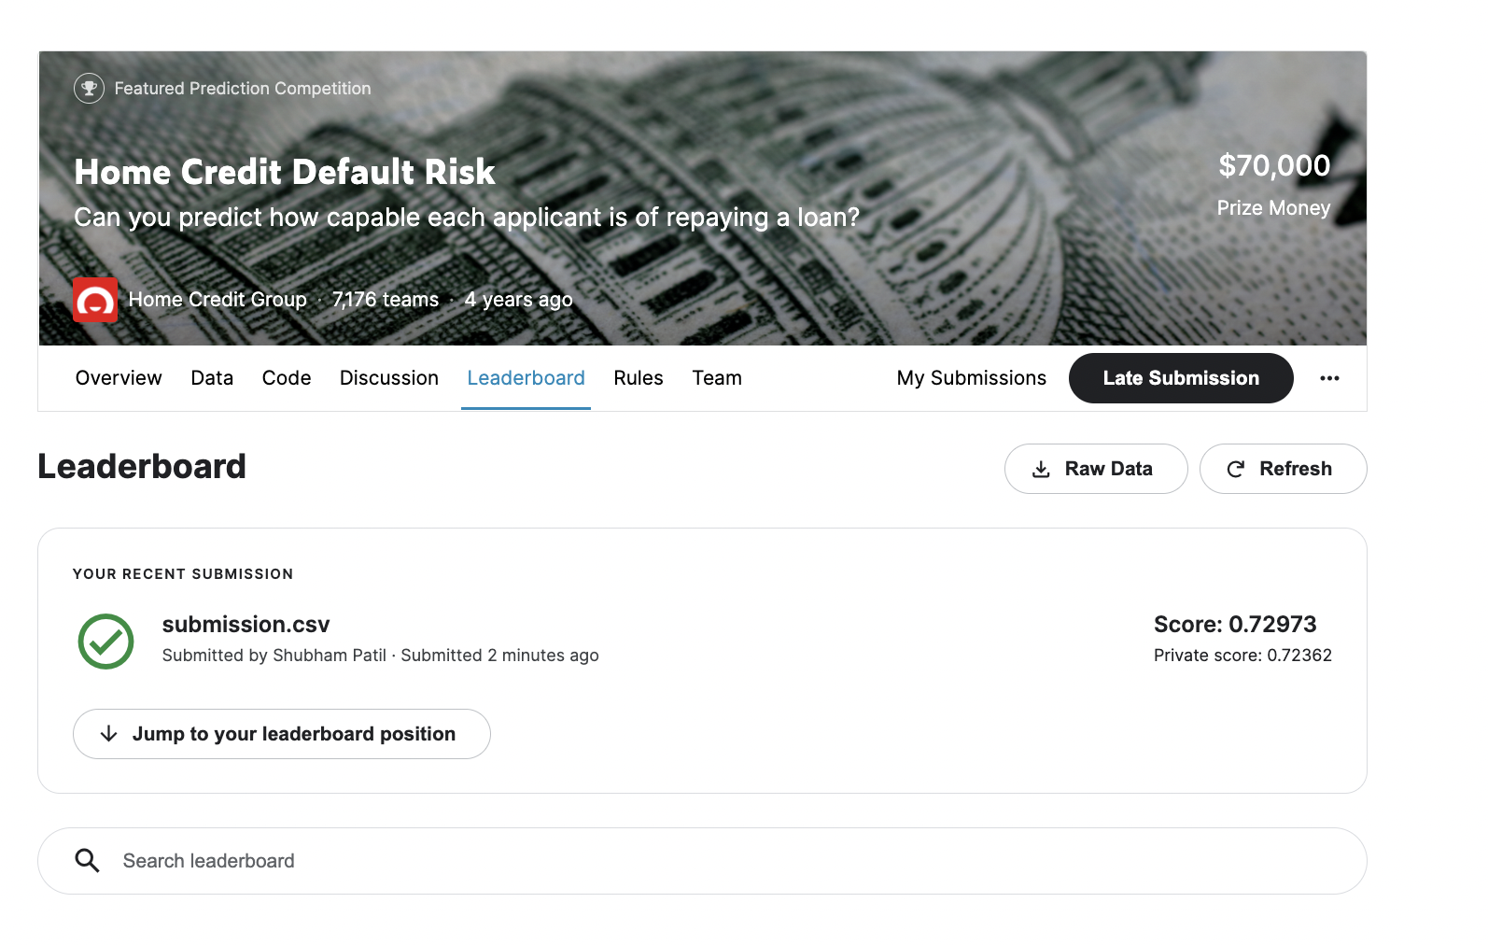
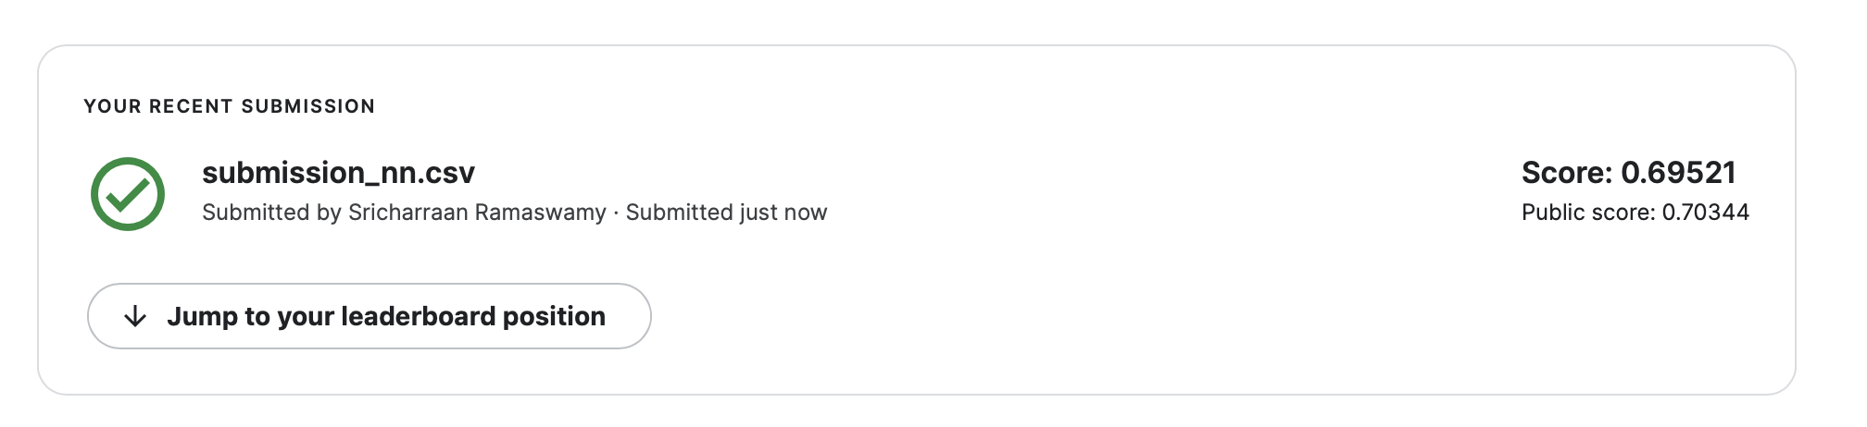
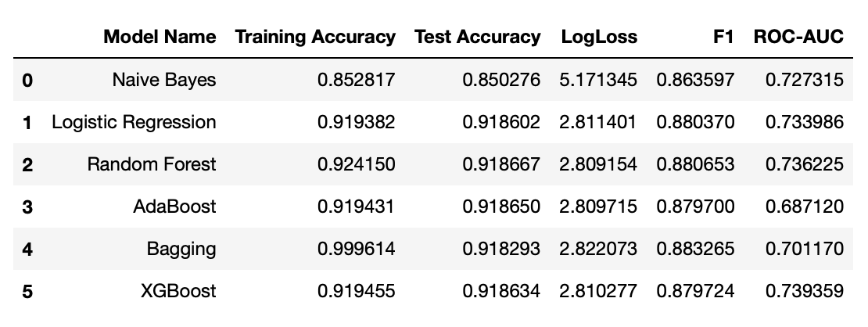
Conclusion and Results
In this last phase we implemented a Multilayer Perceptron(MLP)model using Pytorch for loan default classification.
We infer that the best performing model is XGBoost with testing accuracy of 91.86% and ROC-AUC as 73.9%.
We found out the accuracy for the MLP model to be 91.95% and Kaggle score of 0.69521.
Deep Learning models require huge amount of data to train itself and thus on a longer run Deep Learning models would work best for HCDR classification as compared to usual supervised models.
Future Scope:
This project's future scope could include incorporating embeddings into deep learning models or utilizing advanced classification models such as lightGBM/other boosting models to improve outcomes.

